Slide 1
Software Product Lines
From Paul Clements and Linda Northrop, Software Product Lines: Practices and Patterns
2002 Addison-Wesley

Slide 2
Objectives
Define a software product line
Identify the cost versus benefit trade-offs of software product line engineering
Discuss the three essential activities of software product line engineering
Identify technical and business practices and patterns for software product line engineering

Slide 3
Definition
A software product line is a set of software-intensive systems sharing a common, managed set of features that satisfy the specific needs of a particular market segment or mission and that are developed from a common set of core assets in a prescribed way.

Slide 4
Software Product Lines
Substantial economies can be achieved when the systems in a software product line are developed from a common set of assets in a prescribed way.
In contrast to being developed separately, from scratch.
Each product is formed by taking applicable components from the base of common assets, tailoring them as necessary through preplanned variation mechanisms, adding any new components that may be necessary, and assembling the collection according to the rules of a common, product-line-wide architecture.
Building a new product is more a matter of assembly or generation than one of creation.
Strategic, large-grained reuse.
Notes:
An economy is an area of the production, distribution and trade, as well as consumption of goods and services.

Slide 5
Technical Practices and Business Practices
The common assets and procedures for building products don’t come free:
Organizational foresight
Investment
Planning
Direction
Strategic thinking (beyond a single product)
Software product lines are as much about business practices as they are about technical practices

Slide 6
Software Product Lines are Not:
Fortuitous small-grained reuse:
Such as libraries of algorithms, modules, objects, or components.
Opportunistic reuse, not product-line strategy.
Single system development with reuse from prior projects:
“Clone and own.”
Just component-based development.
Just a reconfigurable architecture (reference architecture, framework).
The architecture is just one asset in the product line’s asset base.
Releases and versions of single products.
Just a set of technical standards.

Slide 7
Core Assets
Architecture
Reusable software components
Domain models
Requirements statements, documentation and specifications
Performance models
Schedules
Budgets
Test plans
Test cases
Work plans
Process descriptions
etc.

Slide 8
Organizational Benefits
Large-scale productivity gains
Improved time-to-market
Maintain market presence
Sustain unprecedented growth
Improve product quality
Achieve reuse goals
Enable mass customization
Compensate for an inability to hire software engineers

Slide 9
Developer Benefits
Get to focus on unique aspects of products instead of redoing the same development for each product
Less painful software integration
Using a validated architecture with components whose integration has already been tested
Fewer stressful schedule delays
Part of a team building products with established quality record and reputation
Greater mobility within the organization because knowledge is beyond a single product
More time to get involved in new technology
More marketable because of knowledge of product-line practices

Slide 10
Architect and Core Asset Developer
Greater challenge to design and build high-quality, robust, and extensible assets that will endure longer
Broader-scoped impact on the organization
If successful, position of technical prominence; leading edge of software design
You will be as marketable as your product line

Slide 11
Customer Benefits
Higher quality
Predictable delivery date and price
Costs of your unique requirements more predictable
Products architected for variability
Well-tested training materials and documentation
Shared cost and experience with other users
Notes:
Higher quality, lower cost of poor quality

Slide 12
End User Benefits
Higher quality system
Fewer defects makes life easer
Better training and support materials
Network of others who have used similar systems
Notes:
Network of others who have used similar systems – Have you ever worked on a project that uses an obscure framework with next to no information online?

Slide 13
Benefits versus Costs
Need specific and solid business goals to be achieved through product-line practice
Substantial start-up investment
On-going costs to maintain and improve assets
Once the product-line approach is established, the organization’s productivity accelerates rapidly
Up-front costs are balanced by repeated accrual of benefits for each product in product line
It takes a certain amount of organizational maturity to field a product line successfully
Notes:
We will go over the benefits and costs for each asset.

Slide 14
Asset: Requirements
Write requirements for the group of systems as a whole
Individual systems specified by a delta or increment to the generic set of requirements
Benefit
Commonality and variation are documented explicitly
Simpler to specify requirements because of reuse and tailoring
Additional Costs
Requirements for a group may require sophisticated analysis and intense negotiation to agree on common requirements and variation points acceptable for all systems
Notes:
Requirements for a group may require sophisticated analysis and intense negotiation to agree on common requirements and variation points acceptable for all systems – this is similar to how we talked about the ATAM and how various stakeholders may want/prioritize different things

Slide 15
Asset: Architecture
The blueprint for how each product is assembled from the components in the asset base
Benefits
Leverage investment in architecture across all products in the product line and subsequent products
The most important design step is largely completed
Additional Costs
Architecture must support the variation inherent in the product line: additional architectural constraints
Greater skills and talents needed to define architecture
Notes:
additional architectural constraints – especially when it comes to modifiability

Slide 16
Asset: Software Components
Building blocks for each product in the product line
Use as-is or tailor according to prespecified variation mechanisms
Benefits
Component interfaces are reused
Component design decisions, data structures, algorithms, documentation, reviews, code, and debugging effort can be leveraged across multiple products in the product line
Additional Costs
Components must be designed to be robust and extensible
Variation points must be built-in or at least anticipated
Generality may have performance trade-offs

Slide 17
Asset: Performance Modeling and Analysis
For products that must meet performance constraints (especially hard or soft real-time constraints), analysis must be performed to show that the system’s performance will be adequate
Benefit
High confidence for a new product because modeling and analysis can be reused from product to product
Process scheduling, network traffic loads, deadlock elimination, data consistency problems, etc. will have already been modeled and analyzed
Additional cost
Reusing the analysis may impose constraints on moving processes among processors, on creation of new processes, or on synchronization of existing processes

Slide 18
Asset: Business Case
Market analysis, marketing collateral, cost and schedule estimates, etc. are built to be generic across the product line
Benefits
Business and management artifacts already exist and can be reused
Additional Costs
Artifacts must be generic, or be made extensible, to accommodate product variations

Slide 19
Asset: Software Development and Change Tools
The infrastructure for turning out a software product and managing core assets requires specific product-line processes and tool support
Benefit
Configuration control boards, configuration management tools and procedures, management processes, and the overall software development processes are in place and have been used before
Tools and environments built or purchased for one product can be amortized across the entire product line
Additional Costs
Boards, processes, tools, and procedures must be more robust to account for unique product-line needs and for managing a product line instead of a single product

Slide 20
Asset: Test Cases, Test Plans, Test Data
Generic testing artifacts for the entire set of products, with variation points to accommodate product variation
Benefits
Test plans, test cases, test scripts, and test data have already been developed and reviewed for the components that are reused
This investment is amortized over the specific products in the product line
Additional Costs
Testing artifacts must be more robust to support more than one product
Testing artifacts must be extensible to accommodate variation among products
Notes:
This investment is amortized over the specific products in the product line – essentially, this means that the value of the investment averages out over the system as a whole, so even if the original investment cost is significant, going further down the line (as you test new products etc) it becomes more worth it

Slide 21
Asset: People, Skills, Training (slide 1 of 2)
By working on a single product at a time, the development staff is actually working on the entire product line
Benefits
Personnel can be moved among product projects more easily
Productivity, when measured by the number of products to which their work applies, raises dramatically
Spending to train developers to use processes, tools, and system components are expended only once
Additional Cost discussed on next slide

Slide 22
Asset: People, Skills, Training (slide 2 of 2)
Additional Costs
Personnel must be trained beyond software engineering and corporate procedures to ensure that they understand software product line practices and can use the assets and procedures associated with the product line
New personnel must be explicitly trained on product line practice and their own product responsibilities
As product line matures, the skills required tend to change, away from programming and toward relevant domain expertise and technology forecasting
This transition must be managed
Notes:
Besides the assets, let’s talk a bit about the investments.

Slide 23
The Investment May Be High (Examples)
Canceling three large projects so that sufficient resources could be devoted to the development of core assets
Reassigning staff who could not adjust to the product line way of doing business
Suspending product delivery for a year while putting the new practices in place

Slide 24
Essential Product Line Activities
Core Asset
Development
Product
Development
Management
Notes:
We will break this down in the upcoming slides

Slide 25
Essential Product Line Activities
Core asset development and product development occur in any order:
New products are built from core assets
Core assets are extracted from existing products
Often, core assets and products are developed in concert
All activities are linked together
Constant iterative motion, essential, and inextricably linked
Notes:
Inextricably = in a way that it is impossible to separate

Slide 26
Strong Feedback Loop Between Core Assets and Products
Core assets are refreshed as products are developed
Use of assets is tracked and results are fed back to the asset development activity
The value of the core assets is realized through the products that are developed from them
Core assets are made more generic by considering potential new products on the horizon

Slide 27
Constant Need for Strong, Visionary Management
Invest resources in the development and sustainment of core assets
Cause the cultural change to view new products in the context of the available assets
Either new products must align with available assets or the assets must be updated to reflect the new products
Iteration is inherent in all activities

Slide 28
Core Asset Development
Goal: establish a production capability for products
Outputs to achieve this goal
Product line scope
Description of what the products have in common and how they vary
Core assets
The basis for production of products in the product line
Production Plan
How products are produced from the core assets

Slide 29
Product Line Scope
A description of the products that will constitute the product line or that the product line is capable of including
At its simplest, an enumerated list of product names
More typically, cast in terms of structure of product family
commonalities and variations
features, operations, performance or other quality attributes, platforms, etc.
Scope too large and scope too small are both challenges

Slide 30
Core Assets
The basis for production of products in the product line
An architecture to guide product assembly from assets
Systematic reuse of all related assets
Architecture models and evaluations
Test plans, test cases
Design documentation
Requirements specifications
Domain models
Off-the-shelf (OTS) components, whether commercial (COTS) or managed open source

Slide 31
The Architecture Asset
A product line architecture must satisfy the needs of the product line in general and the individual products in particular
Explicitly admits variation points
Specifies the structure of the products in the product lines
Provides interface specifications for the components that will be in the asset base
Producing a product line architecture requires
Product line scope
Knowledge of relevant styles, patterns, and frameworks
Any available inventory of pre-existing assets

Slide 32
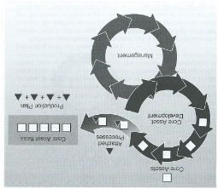
Attached Processes
Each core asset should have an associated attached process that specifies how it will be used in the development of actual products
The attached processes get integrated into a production plan
Core assets
Attached processes
Core asset base
Core asset development
Production plan
Management

Slide 33
Other, Less Technical, Core Assets
Training specific to a product line
Business case for the use of a product line approach for this particular set of products
Technical management process definitions associated with the product line
Identified risks for building products in the product line
Not every core asset will necessarily be used in every product in the product line
All will be used in enough of the products to make their coordinated development, maintenance, and evolution pay off

Slide 34
Plan for Evolution
Define how the core asset base will be updated:
As the product line evolves.
As more resources become available.
As fielded products are maintained.
As technology changes.
As market shifts affect the product line scope.

Slide 35
Production Plan
Describes how the products are produced from the core assets
Integrate the assets’ attached processes with “the necessary glue”
Each product will vary, consistent with predefined variation points
Multiple ways to accommodate the variation
Select from an assortment of components that provided a given feature
Add or delete components
Tailor components via inheritance or parameterization
Generate components automatically
Target level of specificity to background of product builders

Slide 36
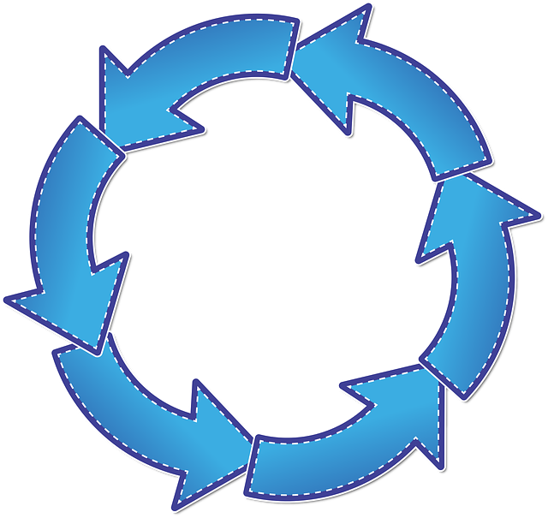
Core Asset Development
Next, Cover Process Inputs
Covered Process Outputs
Product line scope
Product constraints, styles, patterns, frameworks, production constraints, production strategy, inventory of preexisting assets
Core asset development
Core assets production plan
Management

Slide 37
Product Constraints
Commonalities and variations among products in the product line
Behavioral features
Features that market and technology forecasters predict will be useful
Required standards
Performance limits
Interfaces to external systems
Physical constraints
Quality attribute requirements
Core assets must capitalize on the commonalities and accommodate envisioned variation with minimal trade-offs to product quality drivers such as security, reliability, usability, etc.

Slide 38
Styles, Patterns, and Frameworks
Architecture style catalogs explain the properties of particular styles and how well they meet (or not) specific quality attributes
Design pattern catalogs serve the same role at a finer granularity of design
Frameworks are “ecosystems” of selected styles, patterns and other design decisions with supporting development tools and environments
These are all inputs to the product line architecture decisions

Slide 39
Production Constraints
Commercial, military, or company-specific standards
Required underlying infrastructure or middleware
Time-to-market or time-to-initial-operating-capability
Off-the-shelf components used
Legacy components that could or should be reused

Slide 40
Production Strategy
The production strategy is the overall approach for realizing the core assets
Top-down or bottom-up development
How to distribute investment costs among cost centers for products
Buy versus build trade-offs on components
Products automatically generated and/or assembled from assets
Management of production of core assets
Production strategy dictates:
The genesis of the architecture and associated components
The path for growth

Slide 41
Inventory of Preexisting Assets
Legacy systems embody an organization’s domain expertise and/or define its market presence
The product line architecture may borrow heavily from proven structures of related legacy systems
Components may be mined from legacy systems
May embody valuable intellectual property
What organizational assets are available
Libraries, frameworks, algorithms, tools, components
Technical management processes, funding models, and training resources
Inventory is complete – all preexisting assets
Through careful analysis, determine what is most appropriate to utilize

Slide 42
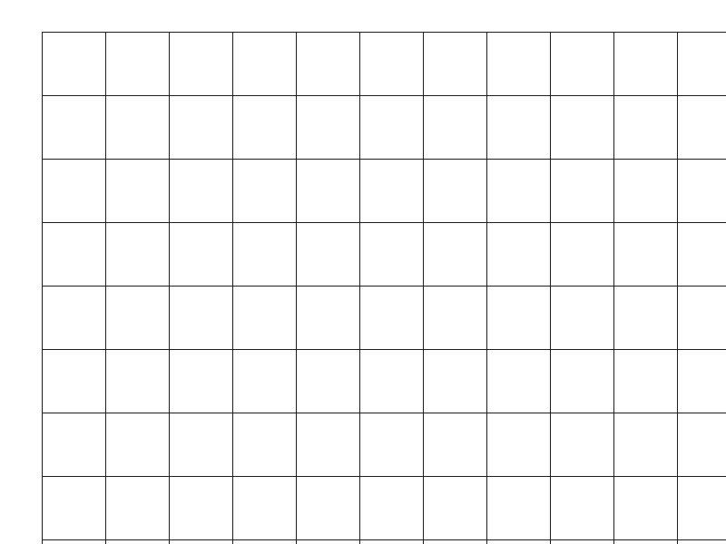
Product Development
Requirements
Product Line Scope
Core Assets
Production Plan
+ +
Product development
Products
Management
This Photo by Unknown Author is licensed under CC BY-SA-NC
This Photo by Unknown Author is licensed under CC BY-SA-NC

Slide 43
Product Development
Mature product line organizations prioritize the health of the product line over that of individual products
But turning out products is the ultimate product line goal
Inputs:
Product-specific requirements – delta or variation
The outputs of core asset development
Product line scope (is this product in scope?)
Core assets
Production plan
Outputs:
Products
Improved product line
Rapid feedback with core asset developers

Slide 44
Management
Allocate and coordinate resources from a strategic, product-line mindset
Separate, yet integrated management of core asset development and product development
Funding model to ensure evolution of core assets
Management of external interfaces – customers and suppliers will be impacted
Contribute to core asset base
Schedules, budgets, and other artifacts used in asset and product development
Need a product line champion

Slide 45
All Three Together
Product Line Development
Each activity is individually essential
A careful blending of all three is also essential
A blend of technology and business practices
Core Asset
Development
Product
Development
Management
Domain Engineering
Application Engineering

Slide 46
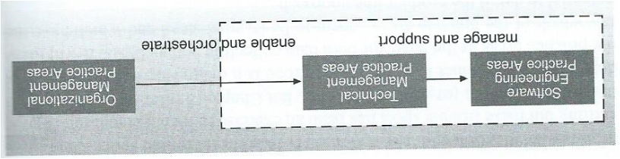
Software Product Line Practice Areas

Slide 47
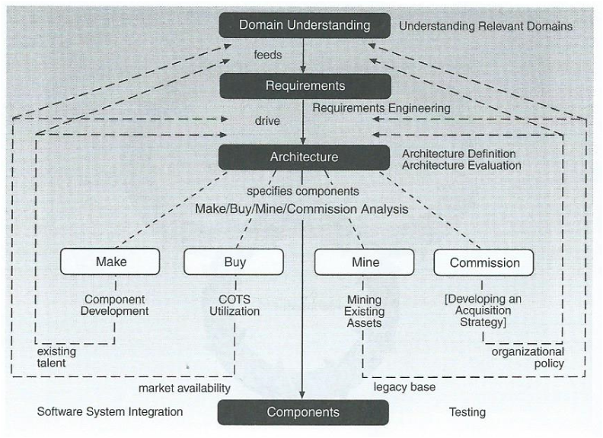
A Catalog of Software Engineering Practice Areas

Slide 48
Software Engineering Practice Areas
Architecture Definition
Architecture Evaluation
Component Development
Off-the-shelf (OTS) Utilization
Mining Existing Assets
Requirements Engineering
Software System Integration
Testing
Understanding Relevant Domains

Slide 49
Technical Management Practice Areas
Configuration Management
Data Collection, Metrics, and Tracking
Make/Buy/Mine/Commission Analysis
Process Definition
Scoping
Technical Planning
Technical Risk Management
Tool Support

Slide 50
Organizational Management Practice Areas
Building a Business Case
Customer Interface Management
Developing an Acquisition Strategy
Funding
Launching and Institutionalizing
Market Analysis
Operations
Organizational Planning
Organizational Risk Management
Structuring the Organization
Technology Forecasting
Training

Slide 51
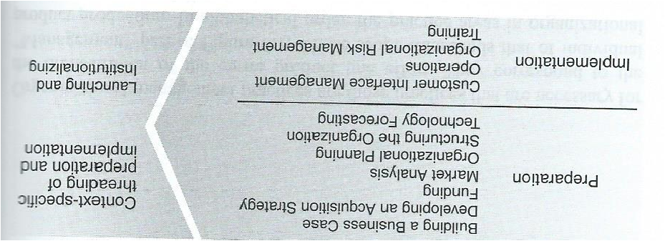
Organizational Management Practice Areas

Slide 52
Patterns of Software Product Line Practices
Curriculum Pattern
Essentials Coverage pattern
Each asset pattern
What to build pattern
Product parts pattern
Assembly line pattern
Monitor pattern
Product builder pattern
Cold start pattern
In Motion pattern
Process pattern
Factory pattern
Notes:
Similarly to architectural patterns, we have software product line practice patterns.

Slide 53
Product Line Technical Probe
Assess an organization’s readiness to adopt, or ability to succeed with, a software product line approach
Structured interviews of small peer groups within the organization
The 29 practices serve as a reference model
Benefits
Baseline “as-is” snapshot of the product line organization
Path to desired “to-be” organization
Identifies strengths to leverage
Opens communication paths among peer groups

Slide 54
Observed Factors of Success
A pressing need that addresses the heart of one’s business
A strong and effective product line champion
Strong and unswerving management commitment
Comfort with a high degree of process discipline
Long and deep experience with the relevant domains of one’s products
Architectural excellence
Loyalty to the product line as a singular entity
Confidence and optimism about the future

Slide 55
The Payoff
Time-to-market slashed from years to days
More than 2x magnitude productivity increase
Higher quality
Increased customer satisfaction
Unequalled product flexibility
Ability to achieve mass customization
Opportunity to move boldly and successfully into new markets
Notes:
This is a possible payoff, but not a guaranteed one

Slide 56
Conclusions
Developing a software product line practice is a risky, but worthwhile, endeavor
There are well-known costs and benefits associated with creating and managing core assets
There are observed practices and patterns for successful adoption of product-line efforts
The Product Line Technical Probe is a technique to assess an organization’s readiness to adopt a software product line approach

